Slide 1
Team Alpha
Status Update
Monday, 11/06
The purpose for our Riki application

Slide 2

The Goals of Our Project
To create a high fidelity platform where users can trust the information present
To keep artificially intelligent bots from infiltrating our platform
To keep our users satisfied with our product by adding features over time

Slide 3


Feature 1 : Account Sign Up
Jacob Bumgartner
This feature allows for the registration of new users, so we can enable each user of the site to have a unique account while not compromising security.
This will include:
-Username availability
-Password confirmation
-Hidden Passwords
-Validations/checks to avoid errors while signing up
-reCAPTCHA checkbox
While working on this feature I will be working alongside Seth to implement his security features into the sign up page

Slide 4
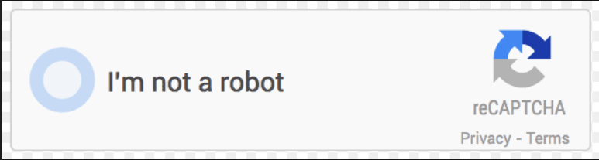
Feature 2: reCAPTCHA for Login
Seth Sutton
Users are prompted with a captcha to ensure they are human actors. The goal Enhance login security by implementing Google's reCAPTCHA to prevent automated bots from accessing the Wiki System.

Slide 5


Feature 3: Multi-factor Authentication
Seth Sutton
Users have a second form of verification through a MFA app on their cellular device to confirm human identity.

Slide 6
Feature 4: History Log for Entries
Eric Jackman
Each entry will have its past versions stored in a recoverable manner allowing users to see all changes to the page.

Slide 7
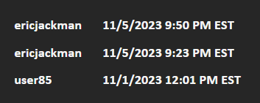
Feature 4: History Log for Entries
Eric Jackman
Requirement 1: The log will be a tab on the editor page and will represent an edit by showing a username and timestamp. (11/13)

Slide 8
Feature 4: History Log for Entries
Eric Jackman
Requirement 2: Clicking any of the entries on the list will restore the page to that previous version. (11/20)
Additionally, 3 unit tests will cover creating, editing, and restoring a page. (11/27)

Slide 9
Feature 5: User Survey when leaving site
Huzaifa Faisal
Users are prompted with a pop up survey when they leave the site to give their feedback to developers which helps to create a more user friendly and pleasant experience.

Slide 10
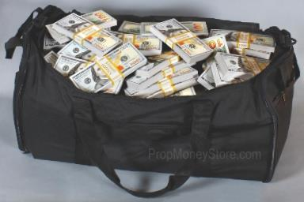
Shareholder Data:
5 Features
10 Unit Tests
Integration Tests as necessary
User Acceptance Test (By a grandmother!)
$50 per month per user
Desired Revenue of $10,000 per month starting January 2024

Slide 11
Milestones
11/20: All features implemented
11/27: All testing completed

Slide 12

AI is here.
Our Riki app aims to create a safe, trusted environment for humans only, making information reliable in an unreliable time.

Slide 13
Are you ready to join a next generation wiki platform?

